Slide 1
Database Management System
Lecture-1

Slide 2
Course Objectives
To be able to understand the underlying concepts of database. And database management system (DBMS)
To introduce students to the concepts of relational data model.
Analysis and design of database application or information systems
Experience with SQL
Implementation of database using SQL

Slide 3
Course Contents at a glance
Introduction to database concepts
Database environment
The Relational Model
Relational Algebra
SQL: Data Manipulation
SQL: Data Definition
Database Planning. Design & Administration
Fact-Finding Techniques
Entity-Relationship Model
Transaction Management
Security

Slide 4
Examples of Database Applications
Purchases from the supermarket
Purchases using your credit card
Booking a holiday at the travel agents
Using the local library
Taking out insurance
Using the internet
Studying at university

Slide 5
File-Based Systems
Early attempts to computerize the manual filing system
Collection of application programs that perform services for the end users (e.g reports)
Each program defines and manages its own data

Slide 6
Manual Filing Systems
Number of items to be stored is small.
For only storage or retrieval functionality of large number of items

Slide 7
File-Based Systems
Consider DreamHome example for file-based systems
Sales Department: responsible for selling and renting properties
Contract Department: responsible for handling lease agreements

Slide 8
Sales Department
PropertyForRent
(propertyNo, street, city, postcode, type, rooms, rent, ownerNo)
Client
(clientNo, fName, lName, tellNo, perftype, maxRent)
PrivateOwner
(ownerNo,fName,lName,address,tellNo)

Slide 9
Contract Department
Lease
(leaseNo, propetyNo, clientNo, rent, paymentMethod, deposit, paid, rentStart, rentFinish, duration)
PropertyForRent
(propertyNo, street, city, postcode, type, rooms, rent)
Client
(clientNo, fName,lName, tellNo, preftype, maxRent)

Slide 10
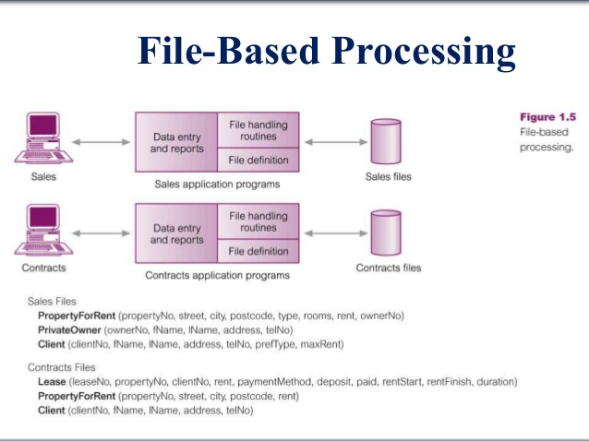

Slide 11
Limitations of File-Based Approach
Separation and isolation of data
Each program maintains its own set of data.
Users of one program may be unaware of potentially useful data held by other programs
For example, if we want to produce a list of all houses that match the requirements of clients.
Duplication of data
Decentralized approach taken by each department
Same data is held by different programs
Wasted space and potentially different values and/or different formats for same item

Slide 12
Limitations of File-Based Approach
Database dependence
File structure is defined in the program code
Incompatible file formats
Programs are written in different languages, and so cannot easily access each other’s files.
Fixed Queries/Proliferation of application programs
Programs are written to satisfy particular functions
Any new requirement needs a new program

Slide 13
Database Approach
Arose because
Definition of data was embedded in application programs, rather than being stored separately and independently.
No control over access and manipulation of data beyond that imposed by application programs
Result
The database and Database Management System (DBMS)

Slide 14
Database
Shared collection of logically related data to meet the requirements of different users of an organization
System catalogue (metadata) provides description of data to enable program-data independence
Logically related data comprises entities, attributes, and relationships of an organization’s information.

Slide 15
Database Management System(DBMS)
A software system that enables users to define, create, maintain, and to control access to the database.
(database) Application program: a computer program that interacts with database by issuing an appropriate request to the DBMS

Slide 16
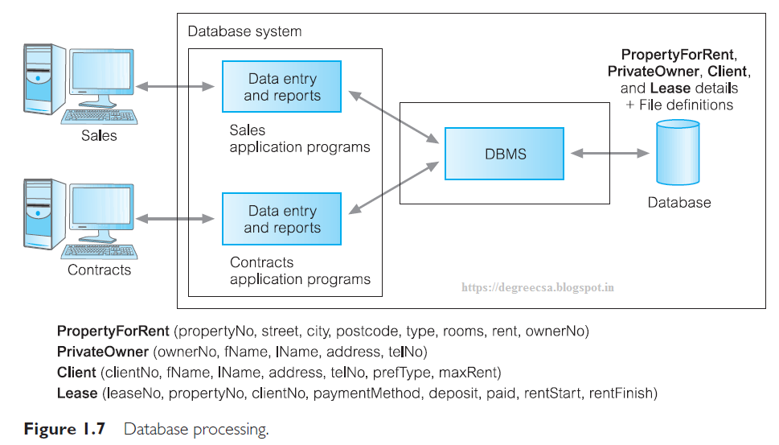

Slide 17
Database Approach
Data Definition Language (DDL)
Permits specification of data types, structures and data constraints.
All specifications are stored in database.
Data Manipulation Language (DML)
General enquiry facility (query language) of the data

Slide 18
Database Approach
Controlled access to database may include:
A security system
Which prevents unauthorized users accessing database
An integrity system
Which maintains the consistency of stored data
A concurrency control system
Which allows shared access of the database
A recovery control system
Which restores the database to a previous consistent state in case of hardware or software failure

Slide 19
Database Approach
A user-accessible catalogue
Which contains description of the data in the database

Slide 20
Views
Allows each user to have his or her own view of the database
A view is essentially some subset of the database

Slide 21
View-Benefits
Reduce complexity
Provide a level of security
Provide a mechanism to customize the appearance of the database
Present a consistent, unchanging picture of the structure of the database, even if the underlying database is changed

